Slide 1
CyberBlock
By: Zach Kelly, Nelson Lau, Xin (Jason) Li, Ridhisha Dangol

Slide 2
Frontend frameworks
react
angular
vue
Free to Use
Most used framework
Great for frequently changed web state
Free to Use
Great for complicated single-page apps
Steeper learning curve
Free to Use
Extracted from Angular
Most lightweight compared to the other two
Notes:
React was chosen, for its widespread use, good for dynamic websites, and previous team experience

Slide 3
BACKend frameworks
Nodejs+expressjs
PYTHON+DJANGO
C#+ASP.NET
Free to Use
Low learning curve
Enable developer to create both front and back end with JS
High performance
Free to Use
Low learning curve
Feature rich
High scalability
Free to Use
Easy maintenance
High performance
Notes:
Node, chosen because of widespread use, flexibility, and previous team experience. When both the frontend and backend are in javascript, there will be a more consistency

Slide 4
Database
MYSQL
MongoDB
GraphDB
Free to Use
Mature Relational Database System
Tables and Rows need to be Defined
Free to Use
Non-Relational Database System
Ideal for Data with Potential for Rapid Growth
Free to Use
Graph Database System
Uses Nodes as Entities
Edges are Relationships
Quick Graph Navigation
Notes:
Mysql, for widespread use, compatibility with web services, and previous experience

Slide 5
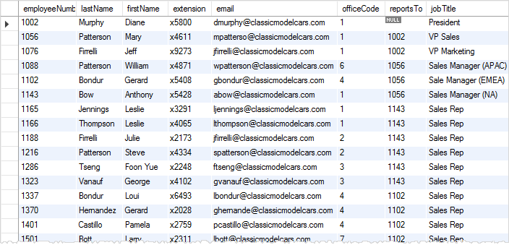
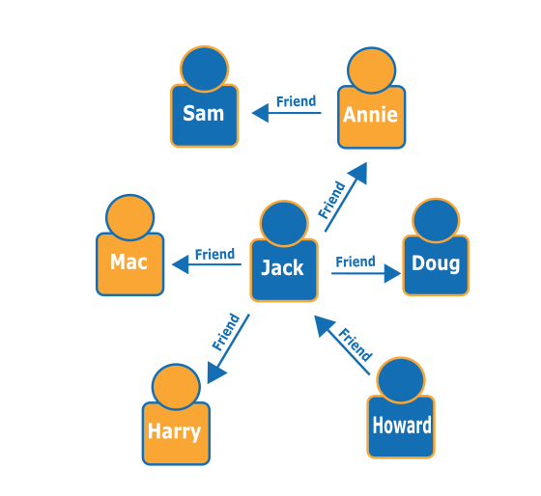
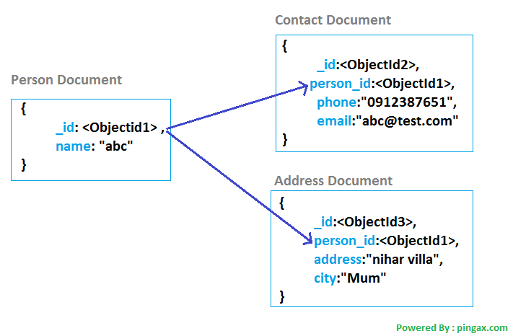

Slide 6



Web Services
Platform as a Service (PaaS)
Faster and Easy Deployment
Good for Small Teams
Computational Demands: Low
Server Deployment: Relatively Simple
Infrastructure as a Service (Iaas)
Difficult to Setup for Beginners
Good for Medium and Large Teams
Computational Demands: High
Server Deployment: Relatively Complicated
Infrastructure as a Service (Iaas)
Difficult to Setup for Beginners
Good for Small and Medium Teams
Computational Demands: High
Server Deployment: Relatively Complicated
Notes:
Paas– Provides environment where we can push out code and some basic configurations and have a running application
Iaas – Give components needed in order to build onto itself
Webserver still up to discussion, but we are leaning more towards Heroku for the webservice, because it

